Slide 1
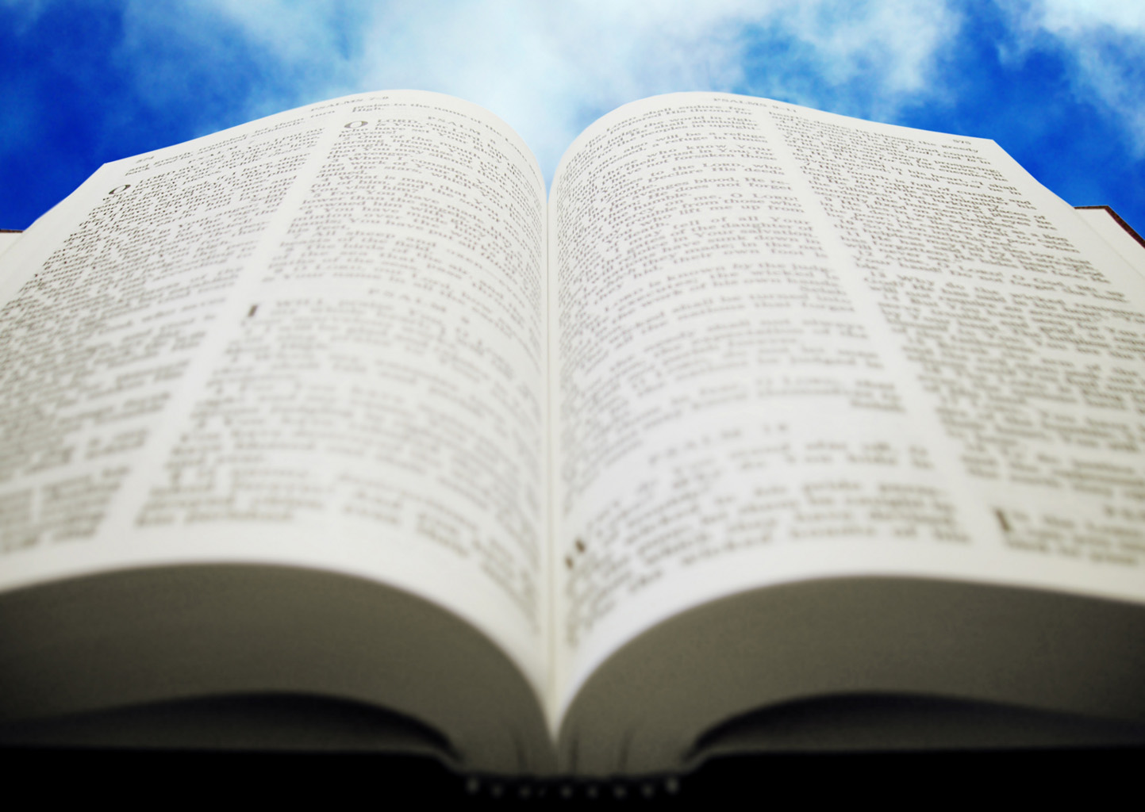
Welcome!
Sunday
Worship 9:30 AM
Sunday
Bible Class (Livestream) 5:00 PM
Wednesday
Bible Class (Livestream) 7:00 PM
www.SunsetchurchofChrist.net

Slide 2
Order of Service
Opening Prayer | Anthony Ward
Song | Grant Haines
Song | Grant Haines
Lord’s Supper | Michael Hetzer
Song | Grant Haines
Lesson | Brian Haines
Song | Grant Haines
Closing | Craig Foster

Slide 3
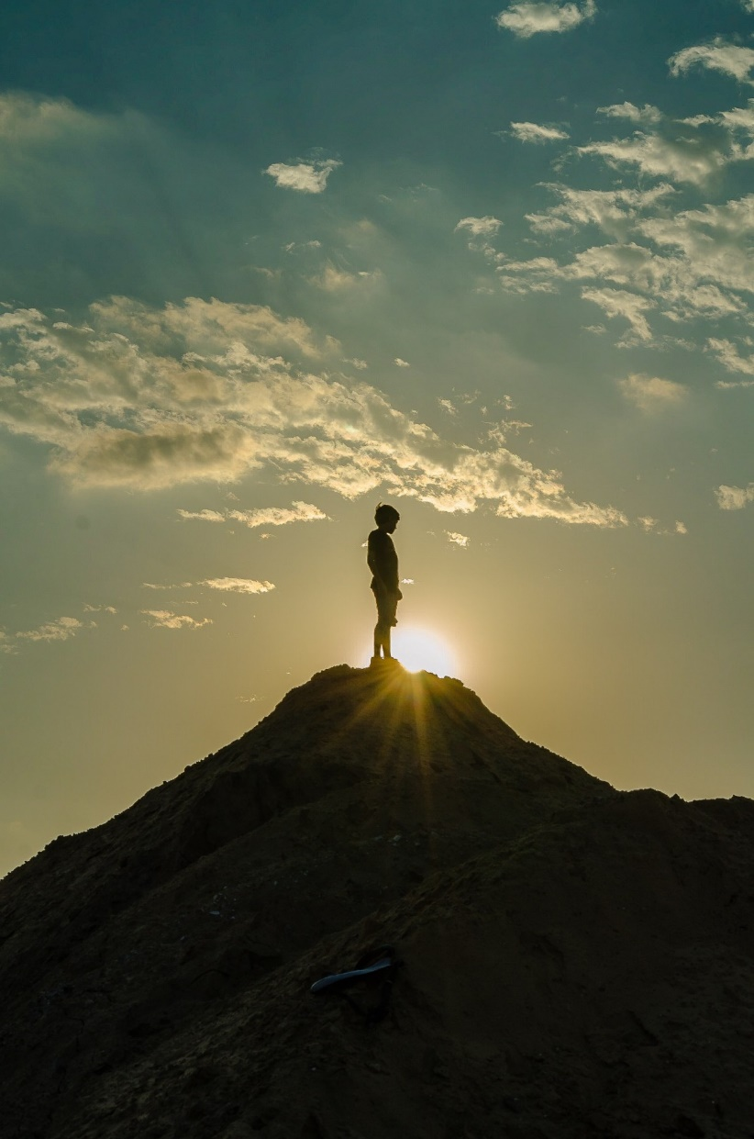
The Great Battle of Knowledge 1 Kings 18:19-40
Notes:
Picture - https://pxhere.com/en/photo/1519731

Slide 4
A War of Wisdoms
Elijah vs. the Baalites: a battle of knowledge
Warring for allegiance
The knowledge of the false gods
- Weather
- Harvests
- Explanations of the universe

Slide 5
A War of Wisdoms
Elijah vs. the Baalites: a battle of knowledge
Warring for allegiance
The knowledge of the false gods
The Knowledge of the True God
- Everything the false gods could explain
- Acceptance of God without images

Slide 6
A War of Wisdoms
Elijah vs. the Baalites: a battle of knowledge
Warring for allegiance
The knowledge of the false gods
The Knowledge of the True God
Who won?

Slide 7
A War of Wisdoms
Elijah vs. the Baalites: a battle of knowledge
Acts 17: Paul vs. the Philosophers
The knowledge of Stoics and Epicurians
The Knowledge of God
Who won?
Notes:
Epicurian: A philosophy advanced by Epicurus that considered happiness, or the avoidance of pain and emotional disturbance, to be the highest good and that advocated the pursuit of pleasures that can be enjoyed in moderation.
The Stoics cared about virtuous behavior and living according to nature,

Slide 8
A War of Wisdoms
Warring wisdoms today
1 Corinthians 1:17-27
The Bible vs. Materialism
How does God make it foolish?
Chaos of worldly knowledge
Notes:
1Co 1:17 ¶ For Christ did not send me to baptize, but to preach the gospel, not with wisdom of words, lest the cross of Christ should be made of no effect. 18 For the message of the cross is foolishness to those who are perishing, but to us who are being saved it is the power of God. 19 For it is written: "I will destroy the wisdom of the wise, And bring to nothing the understanding of the prudent." 20 Where is the wise? Where is the scribe? Where is the disputer of this age? Has not God made foolish the wisdom of this world? 21 For since, in the wisdom of God, the world through wisdom did not know God, it pleased God through the foolishness of the message preached to save those who believe. 22 For Jews request a sign, and Greeks seek after wisdom; 23 but we preach Christ crucified, to the Jews a stumbling block and to the Greeks foolishness, 24 but to those who are called, both Jews and Greeks, Christ the power of God and the wisdom of God. 25 Because the foolishness of God is wiser than men, and the weakness of God is stronger than men. 26 For you see your calling, brethren, that not many wise according to the flesh, not many mighty, not many noble, are called. 27 But God has chosen the foolish things of the world to put to shame the wise, and God has chosen the weak things of the world to put to shame the things which are mighty;

Slide 9
Which Wisdom Wins?
Which will you choose as your own?
James 3:13-18
The wisdom from above
The wisdom of the natural world
Notes:
Isaiah 45:18-23
18 For thus says the LORD, Who created the heavens, Who is God, Who formed the earth and made it, Who has established it, Who did not create it in vain, Who formed it to be inhabited: "I am the LORD, and there is no other. 19 I have not spoken in secret, In a dark place of the earth; I did not say to the seed of Jacob, 'Seek Me in vain'; I, the LORD, speak righteousness, I declare things that are right. 20 ¶ "Assemble yourselves and come; Draw near together, You who have escaped from the nations. They have no knowledge, Who carry the wood of their carved image, And pray to a god that cannot save. 21 Tell and bring forth your case; Yes, let them take counsel together. Who has declared this from ancient time? Who has told it from that time? Have not I, the LORD? And there is no other God besides Me, A just God and a Savior; There is none besides Me. 22 "Look to Me, and be saved, All you ends of the earth! For I am God, and there is no other. 23 I have sworn by Myself; The word has gone out of My mouth in righteousness, And shall not return, That to Me every knee shall bow, Every tongue shall take an oath.

Slide 11
Know Jesus, Know Peace
Hearing and Believing – Romans 10:17
Confessing Jesus as Lord – Romans 10:9
Repentance from sin – Romans 2:4
Baptism in water into Christ – Romans 6:3
Continuing in Christ – Romans 11:22

